Slide 1
CAR Calibration Meeting CAR Review
AP Team
Jacky Wu, Catherine Qiu, Thomas Kestner
Nov 24, 2014

Slide 2
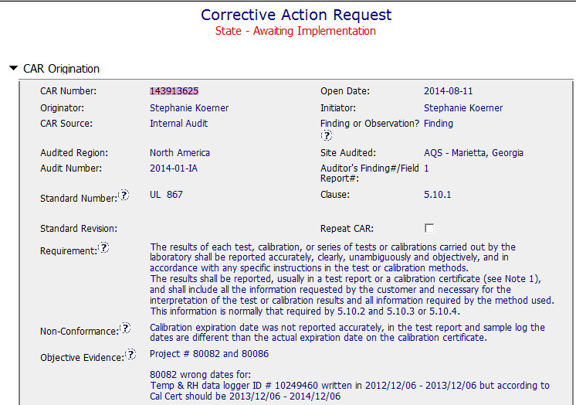
CAR 143913625 - Finding
ISO/IEC 17025 should be identified here, the field means to enter the number of the contains the requirement, the “Clause” and “Requirement” mean the standard number is ISO/IEC 17025
Clearly identified the Requirement, non-conformance, Objective Evidence.

Slide 3
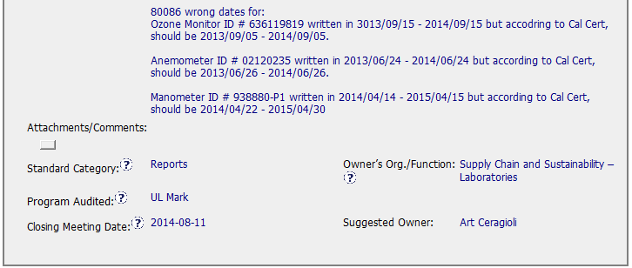
CAR 143913625 - Finding
Objective Evidence shows very clear nonconformance information.

Slide 4
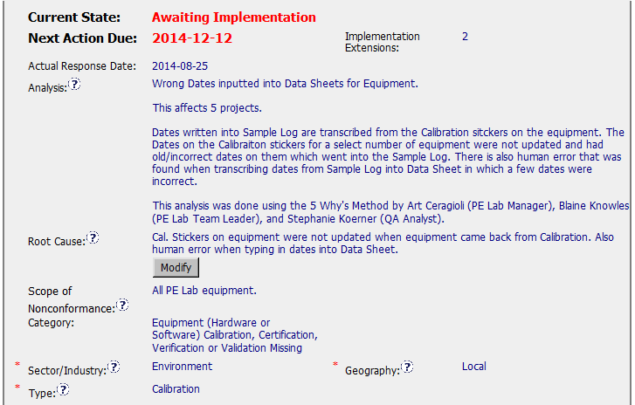
CAR 143913625 - Finding
5 Why’s method was mentioned, I suggested to document it in this field, so that we can see the logical connection from the requirement to the nonconformance to the root cause statement.
" human error" must be supported by facts and data. It should be explored more and documented in Analysis field.
This should be data recording and reporting issue, not be Calibration issue.
(T) Most appropriate ‘category’, ‘type’, ‘geography’ are selected – need improvement
(C) Analysis shows clear path to root cause and scope; stakeholders identified – need improvement
(C) Root cause statement is succinct, reasonable, complete (Shows ‘N/A’ for observations) – need improvement

Slide 5
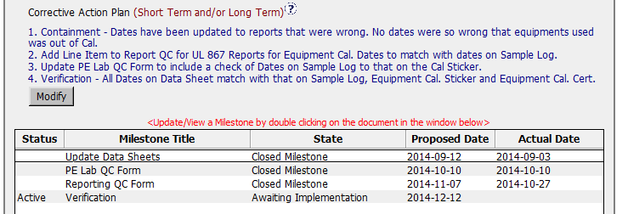
CAR 143913625 - Finding
Item 2&3 corrective actions should have a linkage with “Root Cause” *Linkage - There must be a logical connection from the requirement to the nonconformance to the root cause statement to the corrective action plan.
Containment and Verification actions are well identified.
Milestones were set up excellently
(C) Corrective actions fix the objective evidence and other problems found; address entire root cause and scope. – need improvement

Slide 6
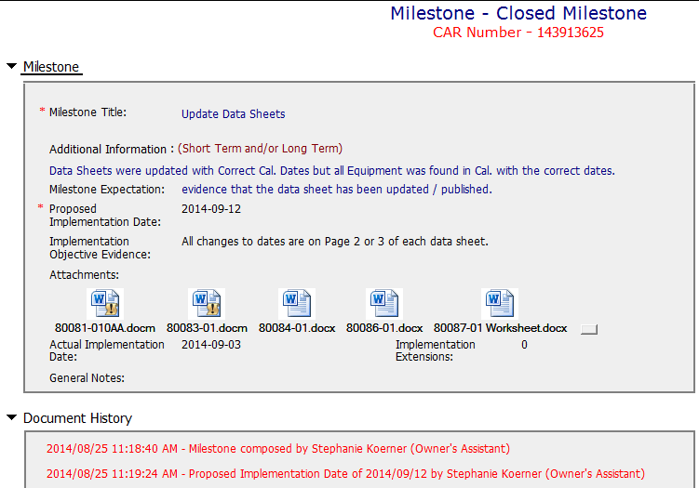
CAR 143913625 – Milestone 1
Containment action has been done with clear implementation objective evidences.
(C) Milestones completed per milestone expectations – excellent

Slide 7
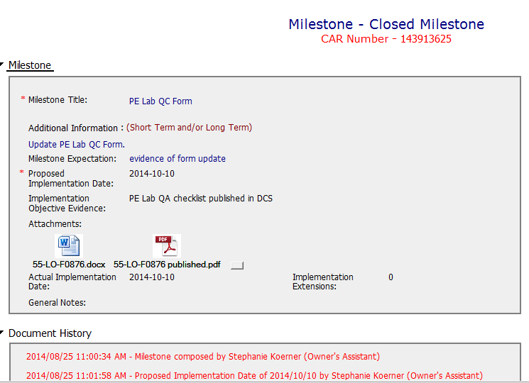
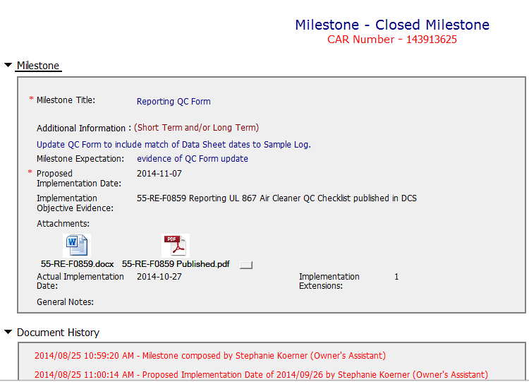
CAR 143913625 – Milestone 2&3
The 2 actions regarding to checklist revision have been done with clear evidences, however no clear linkage with the root cause.
(C) Milestones completed per milestone expectations – excellent

Slide 8
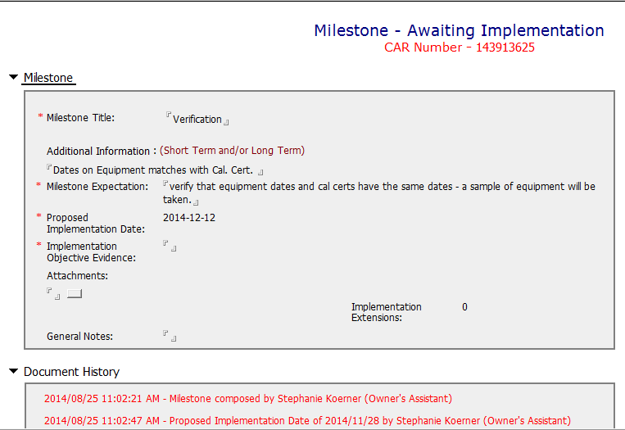
CAR 143913625 – Milestone 4
Not completed, can’t comment any at this time.
(P) Verification per requirements – not completed, due date is Dec 12.

Slide 9
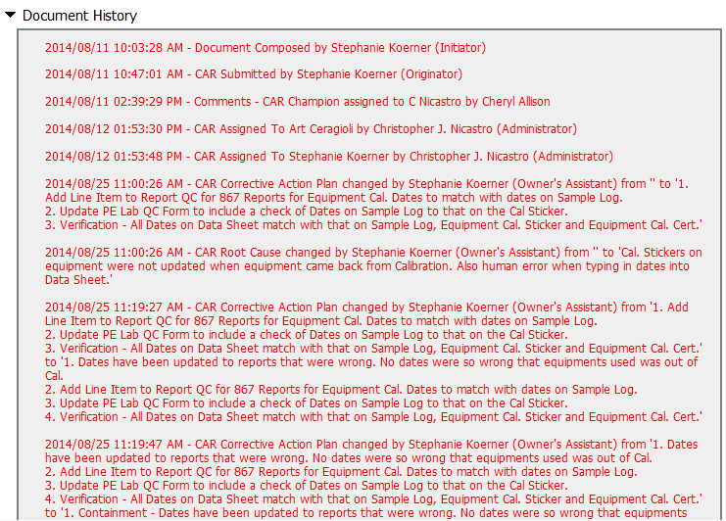
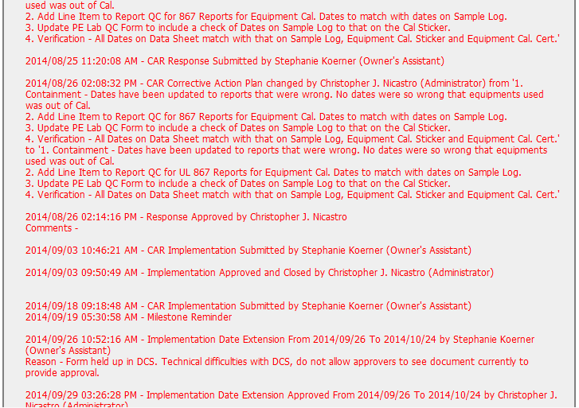
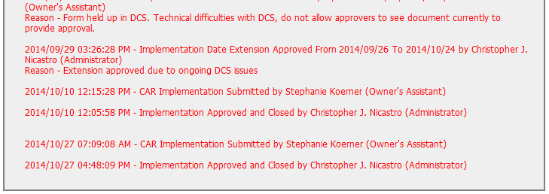
CAR 143913625 – History Study
The comment shows CAR administrator handled the CAR in time, and all actions meet the proposed dates, no overdue, no escalated.
(C) Extensions are within requirement (<30 days, 3 or less)– Excellent
(T) Acts on CARs within required timeframe – Excellent
(C) No Extensions, No overdue, No escalated, No disputed – Excellent

Slide 10
CAR 143913625 – CBS Check
CBS Requirements | Excellent | Moderate | Need Improve | N/A
(C) Extensions are within requirement (<30 days, 3 or less) | X
(T) Most appropriate ‘category’, ‘type’, ‘geography’ are selected |  |  | X
(P) Facilitates the handling of disputed CARs |  |  |  | X
(T) Acts on CARs within required timeframe | X
(C) Analysis shows clear path to root cause and scope; stakeholders identified |  |  | X
(C) Root cause statement is succinct, reasonable, complete (Shows ‘N/A’ for observations) |  |  | X
(C) Corrective actions fix the objective evidence and other problems found; address entire root cause and scope. For observations, they do not go beyond fixing the objective evidence |  |  | X
(C) Milestones address containment & owner’s verification; completed per milestone expectations | X
(P) Verification per requirements |  |  |  | X
(L) Referenced communications are attached as needed |  |  |  | X
(C L) Evidence of communication for overdue/escalated CARs and other pertinent concerns |  |  |  | X
(P) Trains other CAR Champions |  |  |  | X

Slide 11
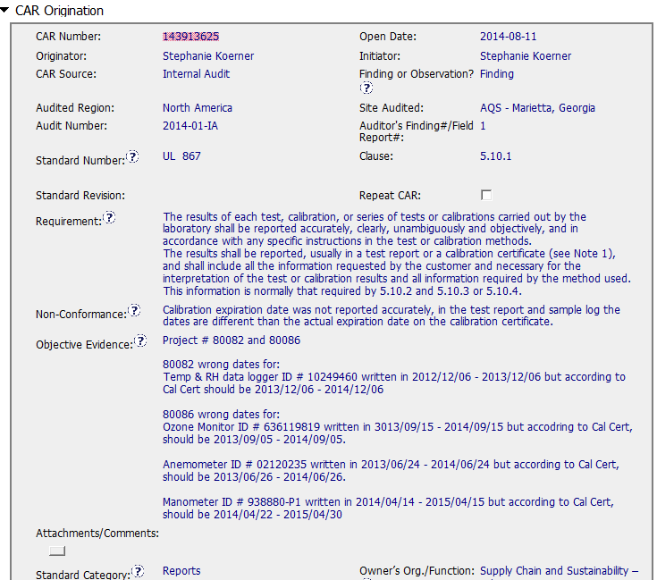
CAR 143913625 - Finding
Good specific
evidence
4 specific instances
of the same issue
Instructions for CAR completion
- Good practice

Slide 12
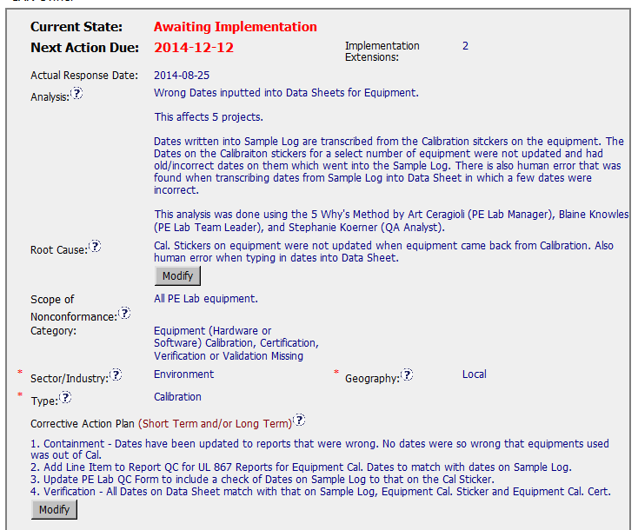
CAR 143913625 - Finding
Limited evidence of 5 Ys
being applied
Human error for 4 instances of the same issue ?
- Root cause not deep enough? – Process issue ?
- 2 root causes stated
Scope inconsistently defined
Other equipment impacted ?
If all equipment no analysis or CA to support this

Slide 13
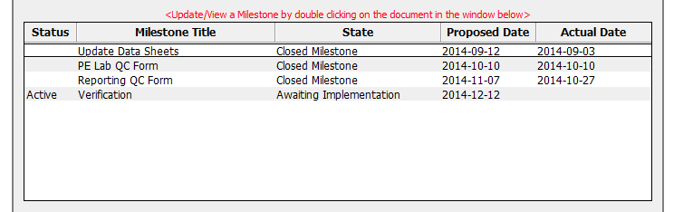
CAR 143913625 - Finding
Data recording containment
Doesn’t address containment of staff transcribing errors
Suggest also include Cal Certs as supporting evidence
No implementation steps related to staff behaviour
DCS link ?
Summary – Analysis and Root cause likely not deep enough to provide an effective Corrective Action plan.

Slide 14
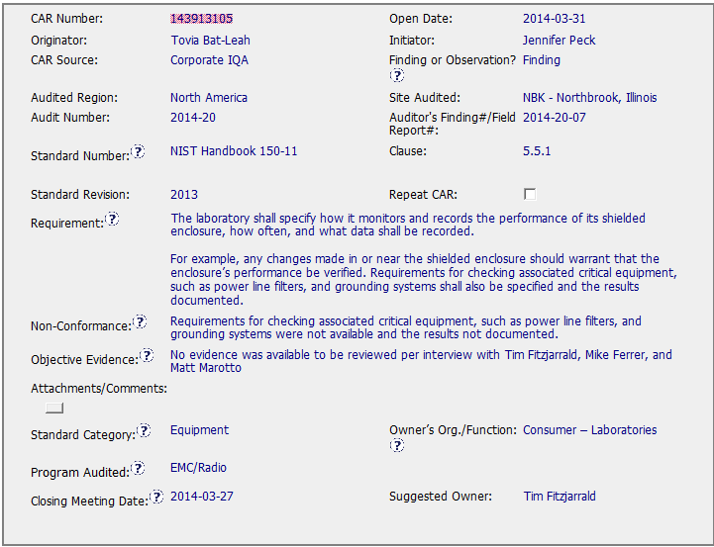
CAR 143913105 - Origination
The Requirement, NC, and OE are clear and concise.

Slide 15
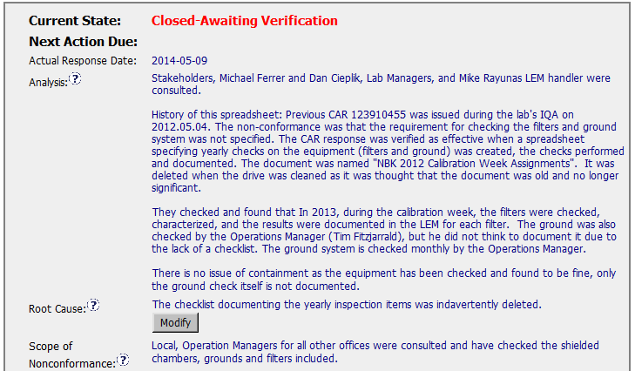
CAR 143913105
Stakeholders and History - Good.
The equipment check is not attached to this CAR to support the suggestion that containment is not required.
Attach results as evidence that the system is checked and acceptable!
It’s probably true, but not the greatest RC statement in the history of Root Cause Analysis.
Evidence of these checks?

Slide 16
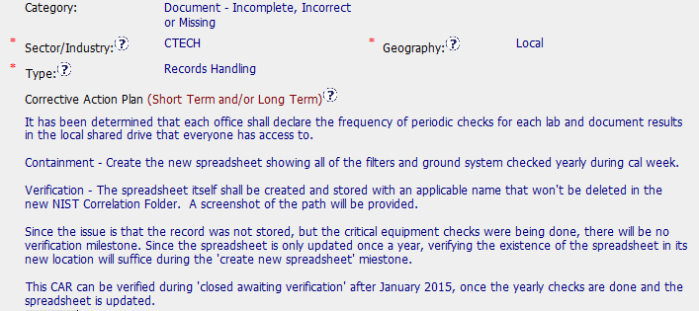
CAR 143913105
Accurate Selections
Evidence of this would be nice!
Explanation of why there is no verification milestone – good, and logical.
Since this spreadsheet is only used once a year this is a good explanation for how the CAR can be verified.
Corrective Action Plan Containment Identified and explained – Good
Verification Identified - Good
How/When Verification will take place – Good
Although all of the individual elements of the CAP are explained well – the overall CAP is somewhat confusing, i.e., the explanation of the verification and containment.

Slide 17
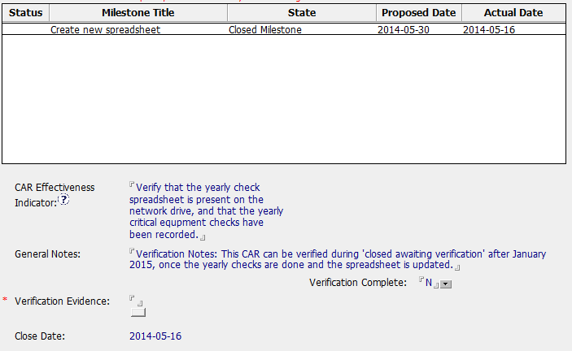
CAR 143913105
Containment should be part of the milestone name.
Example: Containment – Create New Spreadsheet
Milestone closed two weeks ahead of its due date – good!
Good explanation
Helpful, since the CAR Admin may not be the person who attempts to verify the CAR.

Slide 18
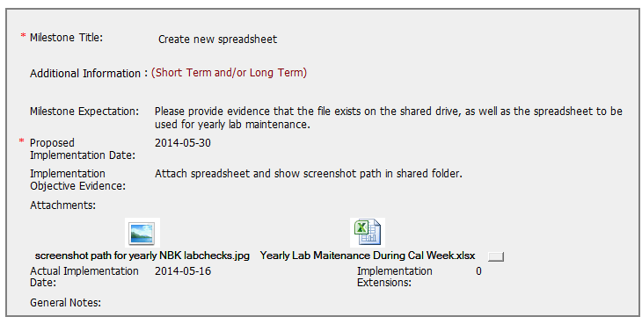
CAR 143913105
Simple, but clear expectation and the objective evidence.

Slide 19
CAR 143913105 Conclusion
CAR History – Very Clear
Comments by CAR Admin after Overdue notice and escalation notice
Response Disapproved note is very clear, with a clear expectation and explanation of what is ‘missing’ in order to approve the response/CAP.
Verification and Progress Check milestones shown as deleted in the CAR History just before the response was accepted. The updated CAP helps to explain this decision
Missing from Response/Analysis
Evidence of the checks to the shielded chambers, grounds, and filters.
(since I was the CAR Admin, I checked my email after reviewing the CAR, and found useful correspondence and a file attachment that would have been good evidence of the past checks which justify why there was no additional containment)
Other Items
Escalation path – good (No BU Presidents or names mentioned in FAQ #36)
CAR Assigned on 4/3 and closed on 5/16. Good!

Slide 20
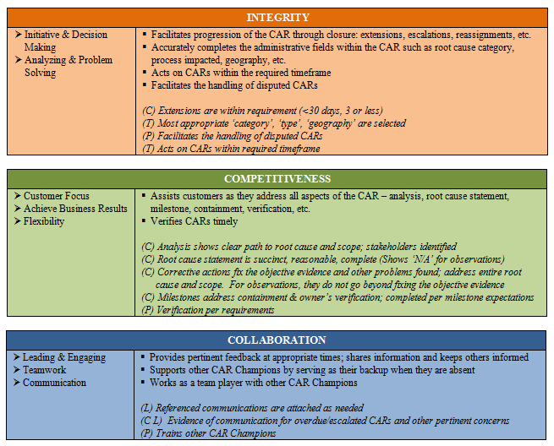
CAR 143913105 – Conclusion / CBS
Yes
N/A
Yes
N/A – Not Yet Verified (Timely, so far!)
Evidence of the checks that are indicated in the analysis are not attached to the CAR – this leaves a small gap in the overall CAP.
Yes
N/A

Slide 21
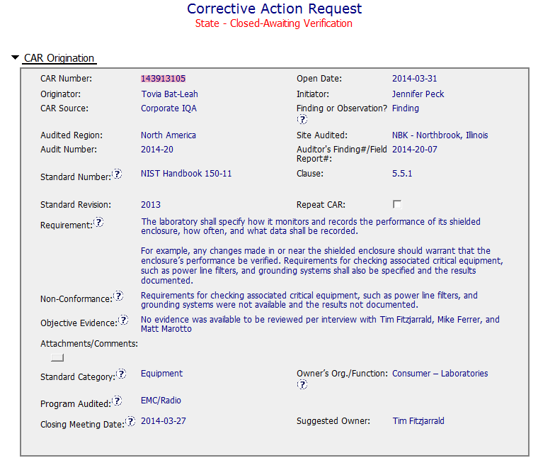
CAR 143913105 - Finding
No unique identifiers for equipment cited e.g.
- Equipment Id
Asset number etc.
Site has multiples chambers and filters
Team recognised this as a repeat CAR but not registered as such
Guidance not available

Slide 22
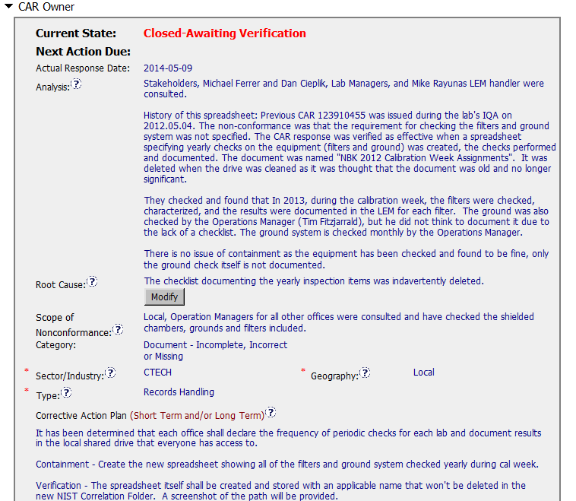
CAR 143913105 - Finding
Stakeholders identified but QM not involved
Limited evidence of structured analysis e.g. 5 Ys.
Scope – equipment and other offices impacted ?
Is trace back required ?
Root cause not deep enough e.g. ‘Ground’ check not documented.
Are requirements and responsibilities understood ?
Process issue ?

Slide 23
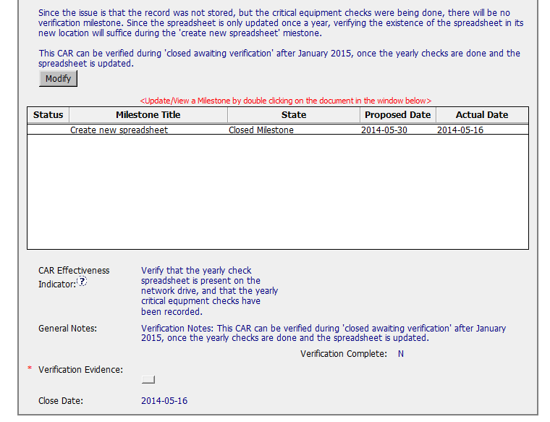
CAR 143913105 - Finding
Containment
Verification milestones ?
Requirements and responsibilities not addressed
Suggest this CAR is reviewed with the owner.

